Slide 1


Slide 2

Welcome To Telkom University

Slide 3


International Certification
Training Program
Big Data Analyst Certification
Blockchain Certification
For Programmers
R- Academy
Python Academy
Non-Programmers
Data Science Training for Business Management
Social Media Analytics Workshop
Data Visualization Training
Big Data for Teens
Smart Contract Blockchain Workshop
Deep Learning Workshop
Parallel Computing
Mastering Data Science Workshop
Scrum Certification
Advance Big Data Certification

Slide 4


print(“Hello, Rizqy!”)

Slide 5

print(“Hello, Dian!”)

Slide 6

print(“Hello, Dhito!”)

Slide 7

print(“Hello, Maholi!”)

Slide 8
Enjoy your Workshop!

Slide 9

Social Media Analytic Workshop
Digital Business Ecosystem Research Center

Slide 10
Handshake with Social Media Analytic
1
Social Media Analytic Workshop

Slide 11
Muhammad Rizqy Dwi Putra
Product Development at Digital Business Ecosystem Research Center
Researcher at Social Computing & Big Data Laboratory
International Big Data Analyst Certification Assistant
Bachelor of Management, Telkom University
Master of Management, Telkom University
Email : rizqydwip@gmail.com
Phone : 085861839096

Slide 12
Research And Publication
Ontology Modelling Approach for Personality Measurement based on Social Media Activity
Measuring Information Dissemination Mechanism on Retweet Network for Marketing Communication Effort
Penentuan Top Brand Menggunakan Social Network Analysis pada E-Commerce Bukalapak dan Tokopedia
Event Driven Motif Exploration of Dynamic Banking Transaction Network

Slide 13
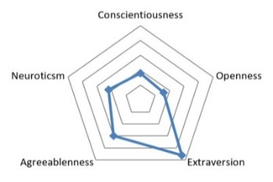
Ontology Modelling Approach for Personality Measurement based on Social Media Activity
Neuroticsm
Anxiety
ribet
aduh
Vulnerability
bingung
Personality (Class)
Facet
(Sub-Class)
Text
(Instance)

Slide 14
Learning Outline
Social Media Analytic Definition
Background
The Benefits of Social Media Analytic
Challenges and Opportunity
Understanding Data
Social Media Analytic Workflow
Social Media Analytic Implementation

Slide 15

Social Media Analytic Definition
Social media analytics (SMA) refers to the approach of collecting data from social media sites and blogs and evaluating that data to make insightful decision making.
It can also analyze online media channels such as news websites, blogs, and forums.

Slide 16
Learning Outline
Social Media Analytic Definition
Background
The Benefits of Social Media Analytic
Challenges and Opportunity
Understanding Data
Social Media Analytic Workflow
Social Media Analytic Implementation

Slide 17

Background
Active Social Media User
Time Spent with Social Media
Human Data Production

Slide 18
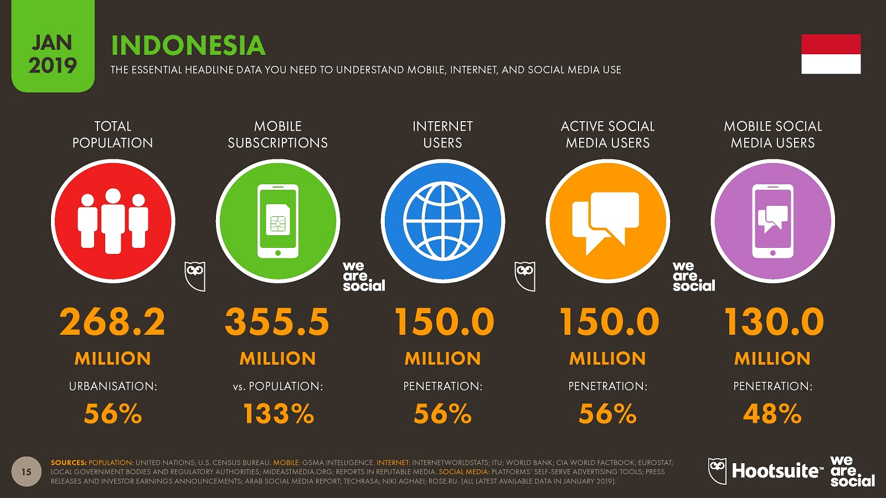

Slide 19
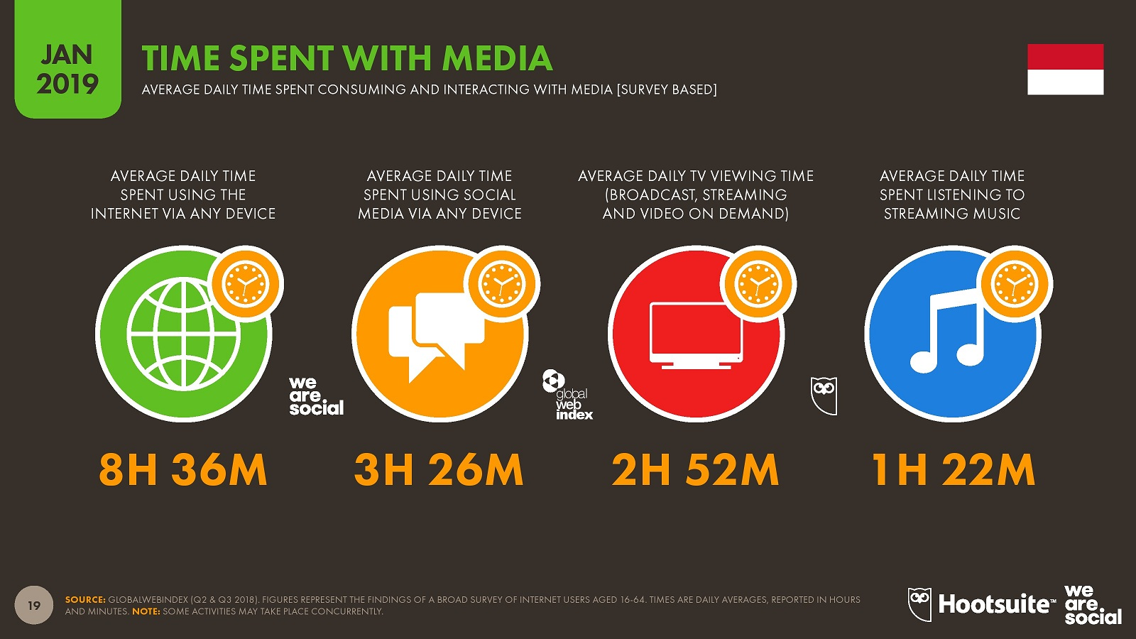

Slide 20
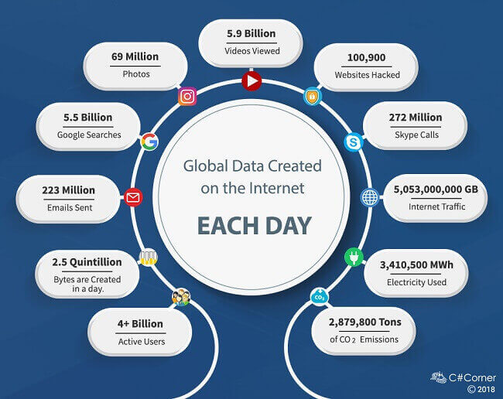
https://www-01.ibm.com/common/ssi/cgi-bin/ssialias?htmlfid=WRL12345USEN

Slide 21
Learning Outline
Social Media Analytic Definition
Background
The Benefits of Social Media Analytic
Challenges and Opportunity
Understanding Data
Social Media Analytic Workflow
Social Media Analytic Implementation

Slide 22
The Benefits of Social Media Analytic
Create winning social media campaigns
Find the best influencers for your brand
Benchmark against your competitors
Identify trending topics

Slide 23
Learning Outline
Social Media Analytic Definition
Background
The Benefits of Social Media Analytic
Challenges and Opportunities
Understanding Data
Social Media Analytic Workflow
Social Media Analytic Implementation

Slide 24
Challenges
Opportunities
Huge volumes of data
Incomplete pictures
Data relevance
Data quality
Uncovering hidden truth
Track social campaigns
Create better content
Competitive benchmarking

Slide 25
Learning Outline
Background
Social Media Analytic Definition
The Benefits of Social Media Analytic
Challenges and Opportunities
Understanding Data
Social Media Analytic Workflow
Social Media Analytic Implementation

Slide 26
Understanding Data
Structured Data
Unstructured Data
High Degree of Organization, such as a relational database
Information that is difficult to organize using traditional mechanisms
Column | Value
Patient | John Brown
Date of Birth | 12/07/1993
Date Admitted | 02/03/2011
“The patient came in complaining of chest pain, shortness of breath, and lingering headaches.. Smokes 2 packs a day.. Family history of heart disease.. Has been experiencing similar symptoms for the past 12 hours…”

Slide 27

Understanding Data
Structured Data
Unstructured Data
Well defined content
Easily Understood
Stored in RDBMS
Easy to enter, store and analyze
Example: data in database table (customer data, sales data, sensor data)
Structure not obvious
Process data to understand
RDBMS not a good fit
Difficult and costly to analyze
Example: email, videos, audio, web pages, social media feeds, presentation

Slide 28
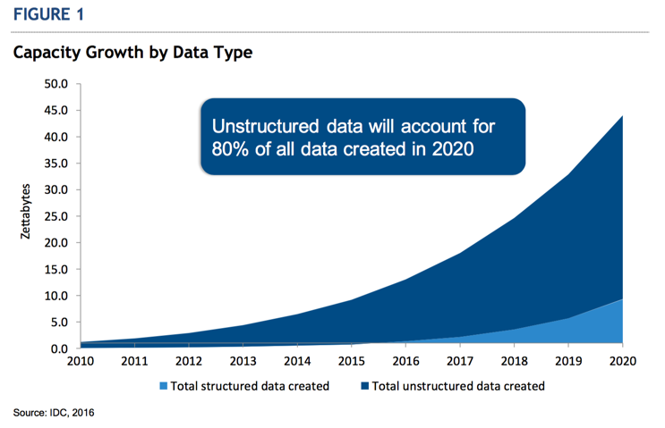
https://www.ibm.com/blogs/cloud-computing/2016/12/13/idc-stacks-top-object-storage-vendors/

Slide 29
Learning Outline
Social Media Analytic Definition
Background
The Benefits of Social Media Analytic
Challenges and Opportunities
Understanding Data
Social Media Analytic Workflow
Social Media Analytic Implementation

Slide 30

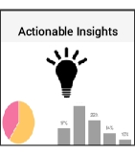
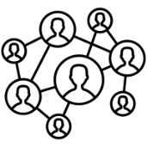

Social Media Analytics Workflow
Social Media Platform
Analytics
Raw Data
Interaction
Content
API Access
Clean Data
Pre-processing

Slide 31
Learning Outline
Social Media Analytic Definition
Background
The Benefits of Social Media Analytic
Challenges and Opportunities
Understanding Data
Social Media Analytic Workflow
Social Media Analytic Implementation

Slide 32
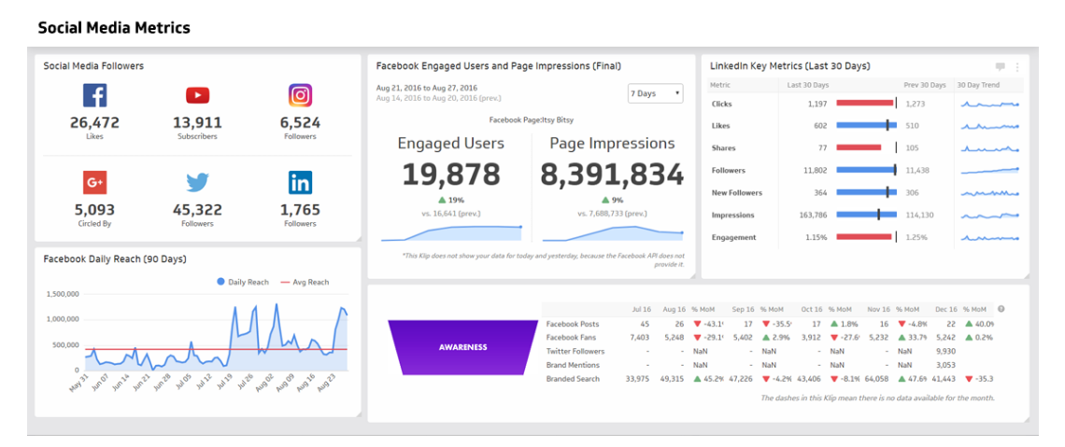
Social Media Analytics Implementation

Slide 33
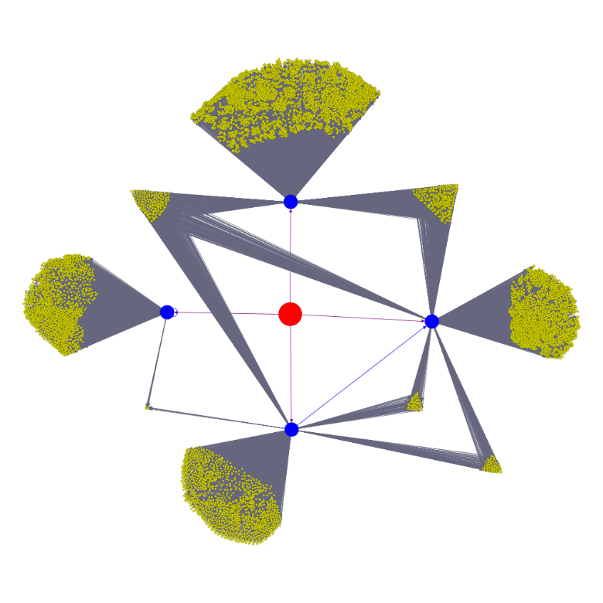
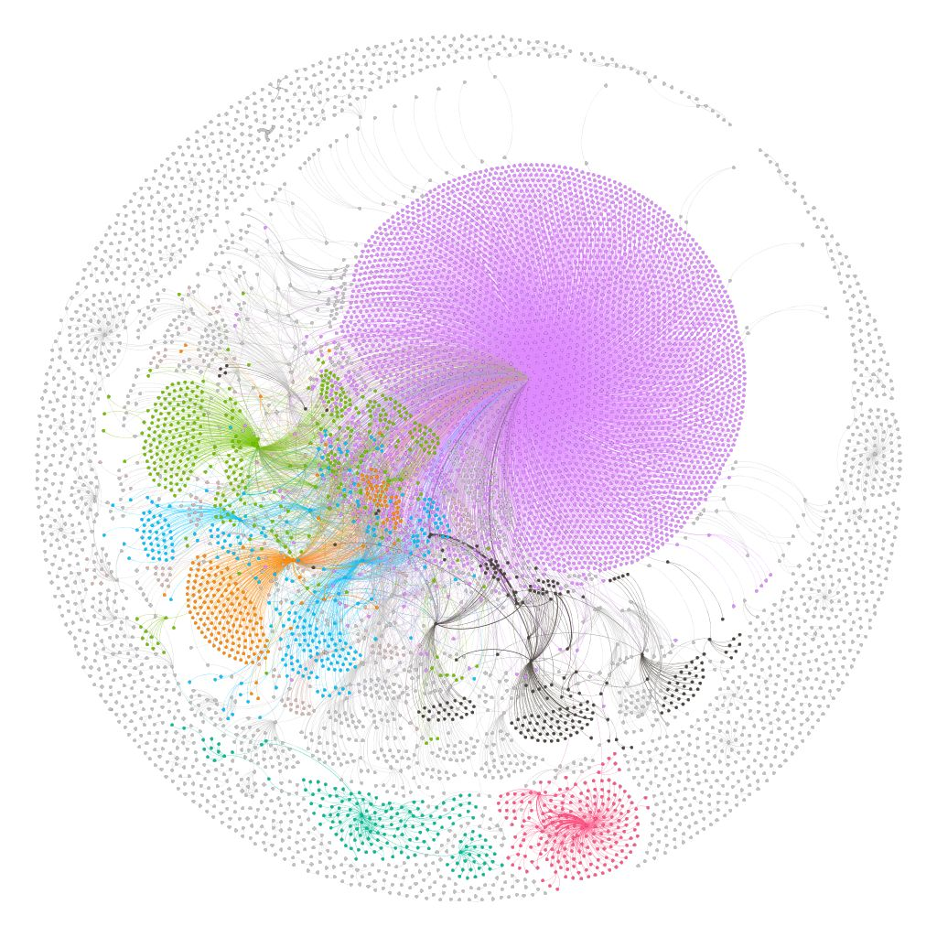
Social Media Analytics Implementation
7203
303
1041
1889
9817
64
43
1663

Slide 34
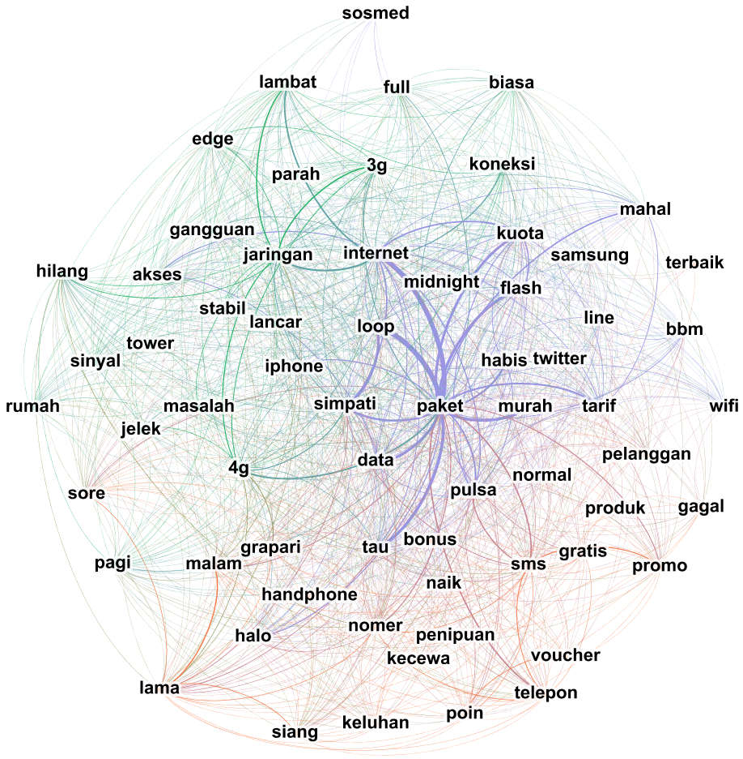
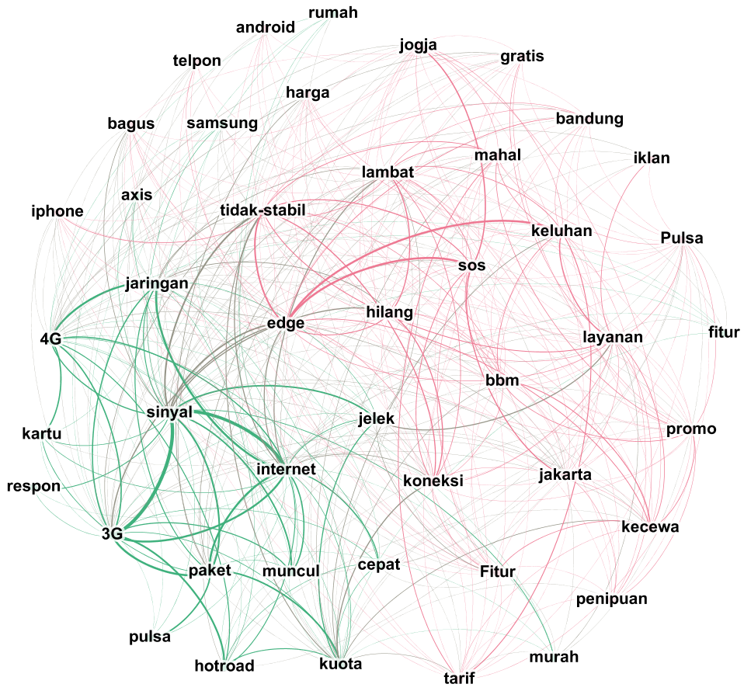
Social Media Analytics Implementation

Slide 35
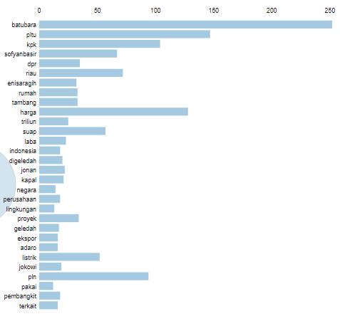
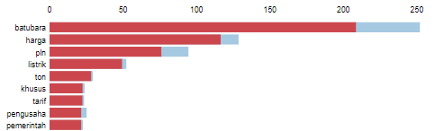
Social Media Analytics Implementation
1st Topic

Slide 36
Say Hai to Social Network Analysis
2
Social Media Analytic Workshop

Slide 37
Dian Puteri Ramadhani
Product Development at Digital Business Ecosystem Research Center
Researcher at Social Computing and Big Data Laboratory
Administrative Team of Asosiasi Ilmuwan Data Indonesia
Bachelor of Management, Telkom University
Master of Management, Telkom University
Email : dianrdn003@gmail.com
Phone : 082240205313

Slide 38
Research And Publication
The Dynamic of Banking Transaction Network Topology, Case Study: Indonesian Presidential Election Event
Event Driven Motif Exploration of Dynamic Banking Transaction Network
Air Transportation Network Robustness under Random and Hub-Based Disruptions
Opinion Leaders Exploration of PT. Net Mediatama Indonesia Using the Social Network Analysis Method for Marketing Alternatives.
Electronic Word-of-Mouth (EWOM) Adoption Model for Information Security Awareness: A Case Study in University Students

Slide 39
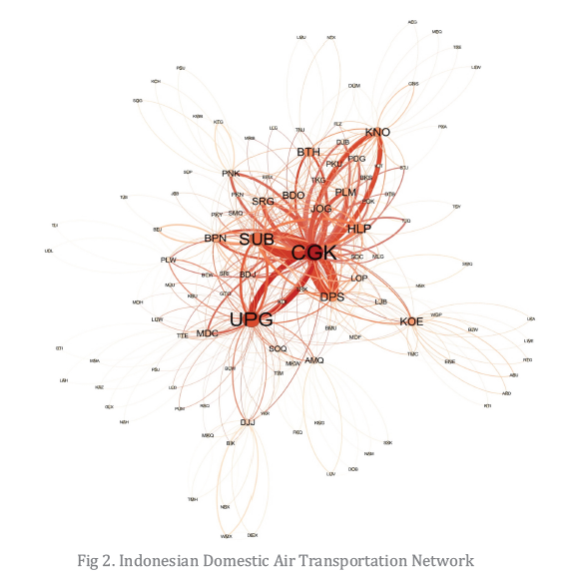
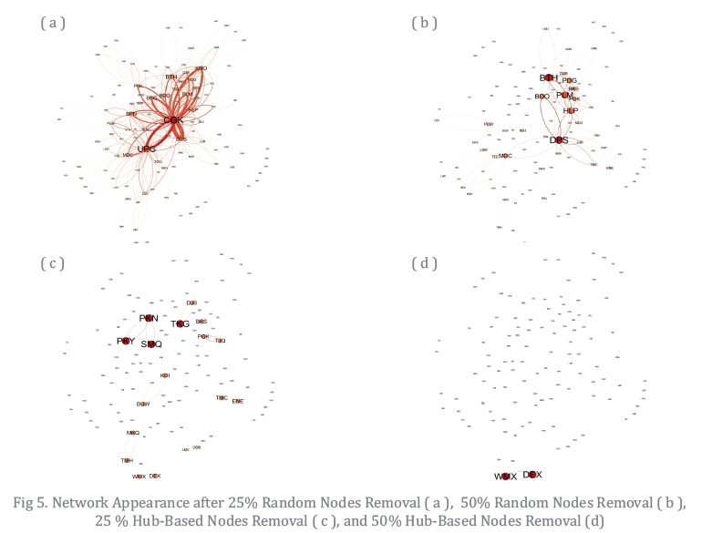

Slide 40
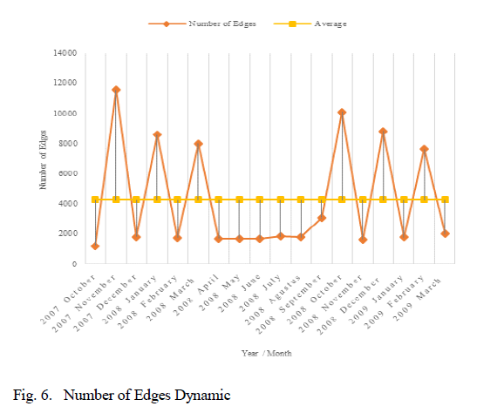
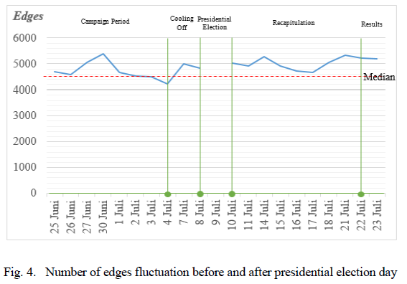

Slide 41
Learning Outline
Handshake with Social Network Analysis
Network Representation
Tie Strength Identification
Influencer Identification
Measuring Overall Social Network Structure

Slide 42
Network
Powerful for describing complex systems by explaining interconnection between elements.
Can be adopted universally in various fields e.g. mathematics, computer science, economics, sociology, chemistry, biology, etc.
It has become essential to understand the real-world systems and gaining complex interactions knowledge

Slide 43
Social Network Analysis
Build upon:
Nodes as users
Edges as interaction flow between users
Graph type to indicate the nature of interaction
Weight to indicate the importance level of an interaction
Focused on relationships and interconnected behaviors of various entities e.g. objects, people and organizations.
The more specific area associated with SNA is the dynamic network behavior study formally known as Dynamic Network Analysis (DNA).

Slide 44
Learning Outline
Handshake with Social Network Analysis
Network Representation
Tie Strength Identification
Influencer Identification
Measuring Overall Social Network Structure

Slide 45
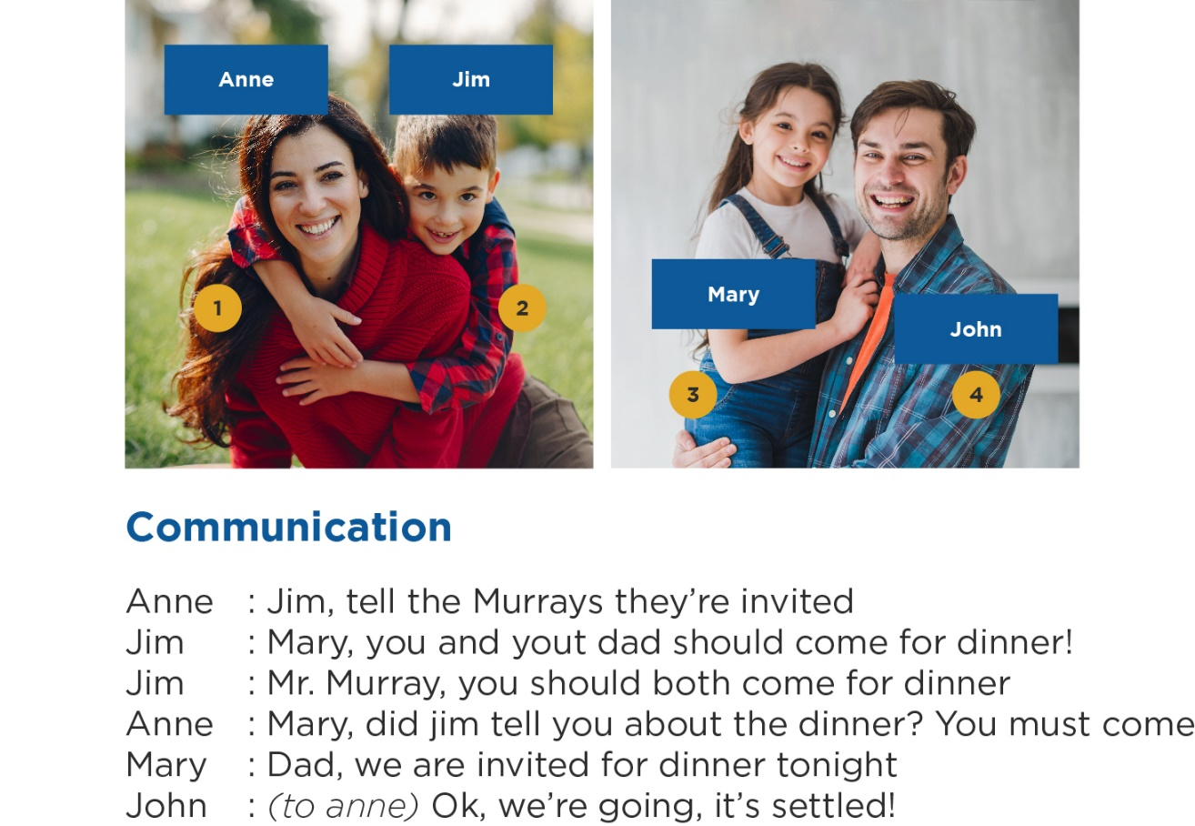
Network Representation (1)
Can we study their interactions
as a network ?

Slide 46
Network Representation (2)
Anne
Jim
Anne : Jim, tell Mary and John they’re invited

Slide 47
Network Representation (3)
Anne
Jim
Mary
Anne : Jim, tell Mary and John they’re invited
Jim : Mary, you and your dad should come for dinner

Slide 48
Network Representation (4)
Anne
Jim
John
Mary
Anne : Jim, tell Mary and John they’re invited
Jim : Mary, you and your dad should come for dinner
Jim : Mr. John, you should both come for dinner

Slide 49
Network Representation (5)
Anne
Jim
John
Mary
Anne : Jim, tell Mary and John they’re invited
Jim : Mary, you and your dad should come for dinner
Jim : Mr. John, you should both come for dinner
Mary : Dad, we are invited for tonight

Slide 50
Network Representation (6)
Anne
Jim
John
Mary
Anne : Jim, tell Mary and John they’re invited
Jim : Mary, you and your dad should come for dinner
Jim : Mr. John, you should both come for dinner
Mary : Dad, we are invited for tonight
Anne : John, did Jim tell you about the dinner? You must come

Slide 51
Network Representation (7)
Anne
Jim
John
Mary
Anne : Jim, tell Mary and John they’re invited
Jim : Mary, you and your dad should come for dinner
Jim : Mr. John, you should both come for dinner
Vertex
Edges
Mary : Dad, we are invited for tonight
Anne : John, did Jim tell you about the dinner? You must come

Slide 52
Network Representation (8)
Directed Network
Anne
Jim
Edge List
Adjacency Matrix
Vertex | Vertex
Anne | Jim
Anne | John
Jim | John
Jim | Mary
Mary | John
Vertex | Anne | Jim | John | Mary
Anne | - | 1 | 1 | 0
Jim | 0 | - | 1 | 1
John | 0 | 0 | - | 0
Mary | 0 | 0 | 1 | -
John
Mary
Vertex
Edges

Slide 53
Network Representation (9)
Undirected Network
Anne
Jim
Edge List
Adjacency Matrix
Vertex | Vertex
Anne | Jim
Anne | John
Jim | John
Jim | Mary
Mary | John
Vertex | Anne | Jim | John | Mary
Anne | - | 1 | 1 | 0
Jim | 1 | - | 1 | 1
John | 1 | 1 | - | 1
Mary | 0 | 1 | 1 | -
John
Mary
Vertex
Edges

Slide 54
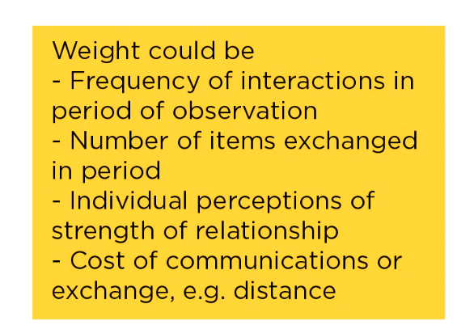
Network Representation (10)
Weighted Network
Anne
30
Jim
Edge List
Adjacency Matrix
Vertex | Vertex | Weight
Anne | Jim | 30
Anne | John | 5
Jim | John | 22
Jim | Mary | 2
Mary | John | 27
Vertex | Anne | Jim | John | Mary
Anne | - | 30 | 5 | 0
Jim | 30 | - | 22 | 2
John | 5 | 22 | - | 1
Mary | 0 | 2 | 37 | -
5
22
2
John
37
Mary
Vertex
Edges

Slide 55
Learning Outline
Handshake with Social Network Analysis
Network Representation
Tie Strength Identification
Influencer Identification
Measuring Overall Social Network Structure

Slide 56
Edge Weight as Relationship Strength
Edges can represent interactions, flows of information or goods, similarities/affiliations, or social relations
Specifically for social relations, a ‘proxy’ for the strength of a tie can be:
Surveys and interviews allows us to establish the existence of mutual or one-sided strength/affection with greater certainty, but proxies above are also useful
The frequency of interaction or the amount of exchange
Reciprocity in interaction or flow
The type of interaction or flow between the two parties (e.G., Intimate or not)
Other attributesof the nodes or ties (e.G., Kin relationships)
The structure of the nodes’ neighborhood (e.G. Many mutual ‘friends’)

Slide 57
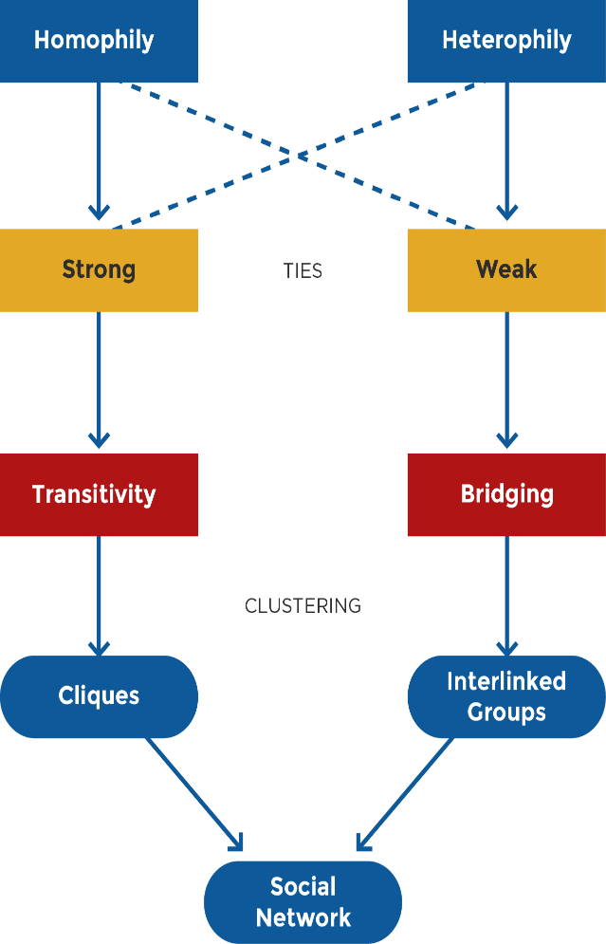
Homophily, Transitivity, and Bridge
Homophily is the tendency to relate to people with similar characteristics (status, beliefs, etc.)
Transitivity in SNA is a property of ties: if there is a tie between A and B and one between B and C, then in a transitive network A and C will also be connected
Bridges are nodes and edges that connect across groups

Slide 58
Learning Outline
Handshake with Social Network Analysis
Network Representation
Tie Strength Identification
Influencer Identification
Measuring Overall Social Network Structure

Slide 59
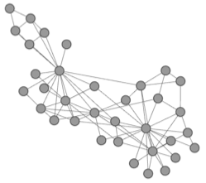
Who is Important?

Slide 60
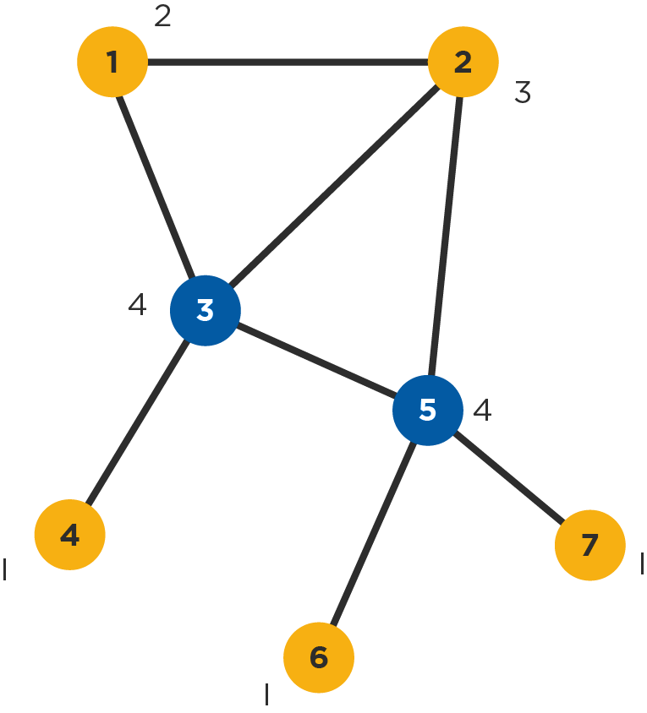
Degree Centrality
A node’s (in-) or (out-) degree is the number of links that lead into or out of the node
In an undirected graph they are of course identical
Often used as measure of a node’s degree of connectedness and hence also influence and/or popularity
Useful in assessing which nodes are central with respect to spreading information and influencing others in their immediate ‘neighborhood’
Nodes 3 and 5 have the highest degree (4)

Slide 61
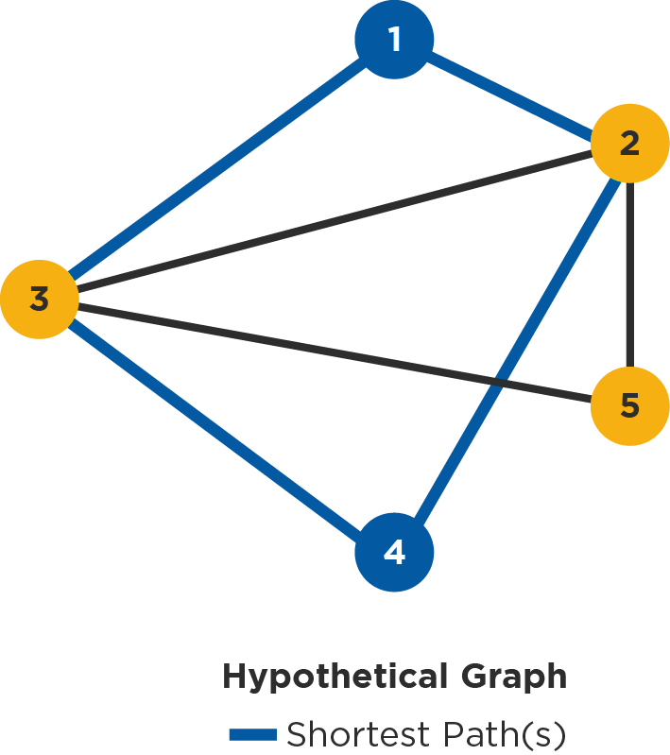
Paths and Shortest Paths
A path between two nodes is any sequence of non-repeating nodes that connects the two nodes
The shortest path between two nodes is the path that connects the two nodes with the shortest number of edges (also called the distance between the nodes)
In the example to the right, between nodes 1 and 4 there are two shortest paths of length 2: {1,2,4} and {1,3,4}
Other, longer paths between the two nodes are {1,2,3,4}, {1,3,2,4}, {1,2,5,3,4} and {1,3,5,2,4} (the longest paths)
Shorter paths are desirable when speed of communication or exchange is desired (often the case in many studies, but sometimes not, e.g. in networks that spread disease)

Slide 62
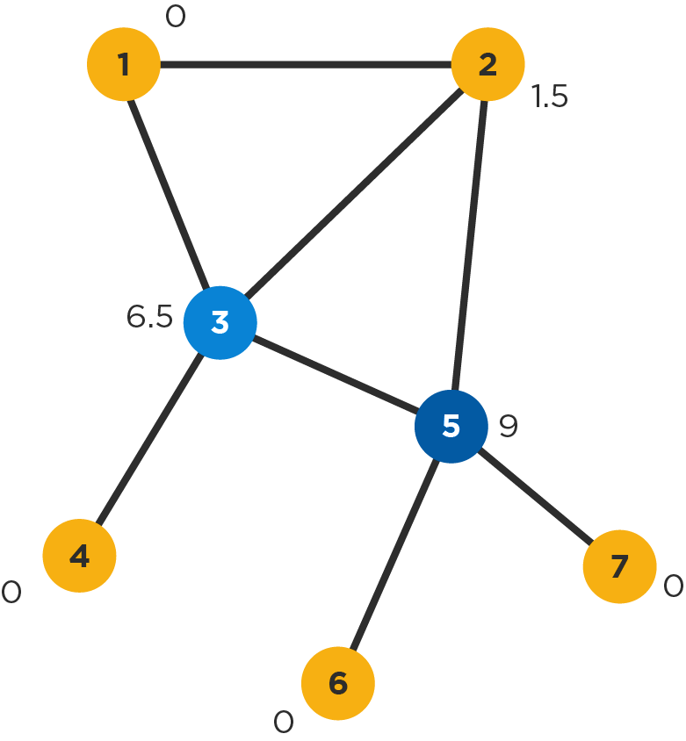
Betweenness Centrality
For a given node v, calculate the number of shortest paths between nodes i and j that pass through v, and divide by all shortest paths between nodes i and j
Sum the above values for all node pairs i,j
Sometimes normalized such that the highest value is 1 or that the sum of all betweenness centralities in the network is 1
Shows which nodes are more likely to be in communication paths between other nodes
Also useful in determining points where the network would break apart (think who would be cut off if nodes 3 or 5 would disappear)
Node 5 has higher betweenness centrality than 3

Slide 63
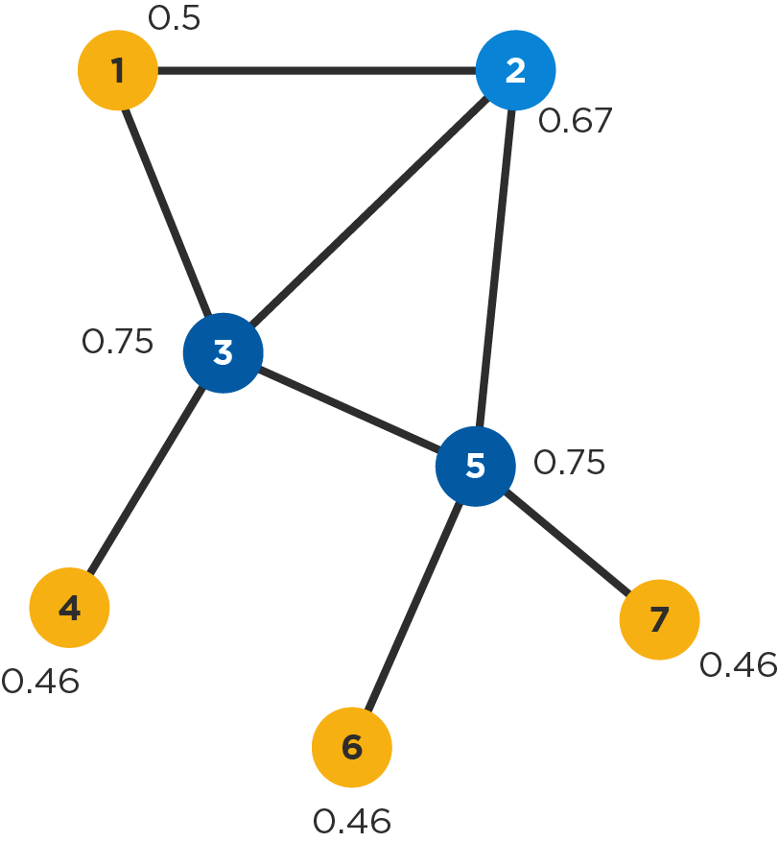
Closeness Centrality
Calculate the mean length of all shortest paths from a node to all other nodes in the network (i.e. how many hops on average it takes to reach every other node)
Take the reciprocal of the above value so that higher values are ‘better’ (indicate higher closeness) like in other measures of centrality
It is a measure of reach, i.e. the speed with which information can reach other nodes from a given starting node
Note: Sometimes closeness is calculated without taking the reciprocal of the mean shortest path length. Then lower values are ‘better’.
Nodes 3 and 5 have the highest (i.e. best) closeness, while node 2 fares almost as well

Slide 64
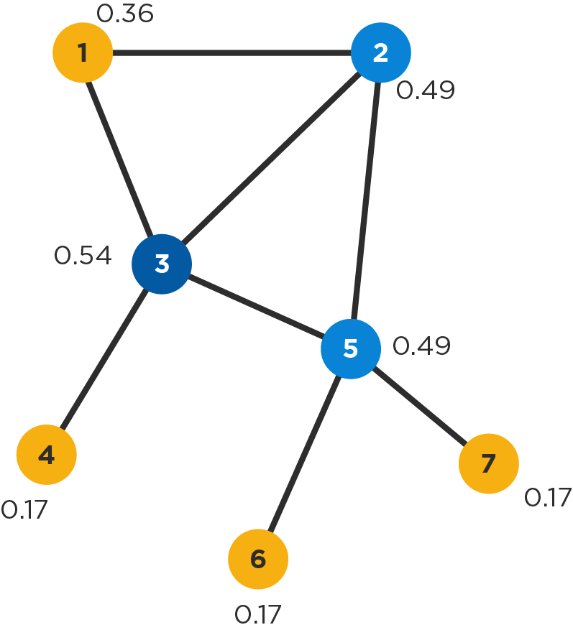
Eigenvector Centrality
A node’s eigenvector centrality is proportional to the sum of the eigenvector centralities of all nodes directly connected to it
In other words, a node with a high eigenvector centrality is connected to other nodes with high eigenvector centrality
This is similar to how Google ranks web pages: links from highly linked-to pages count more
Useful in determining who is connected to the most connected nodes
Note: The term ‘eigenvector’ comes from mathematics (matrix algebra), but it is not necessary for understanding how to interpret this measure
Node 3 has the highest eigenvector centrality, closely followed by 2 and 5

Slide 65
Interpretation of Measures
Centrality measure
Interpretation in social networks
Degree
Betweenness
Closeness
Eigenvector
How many people can this person reach directly?
How likely is this person to be the most direct route between two people in the network?
How fast can this person reach everyone in the network?
How well is this person connected to other well-connected people?

Slide 66
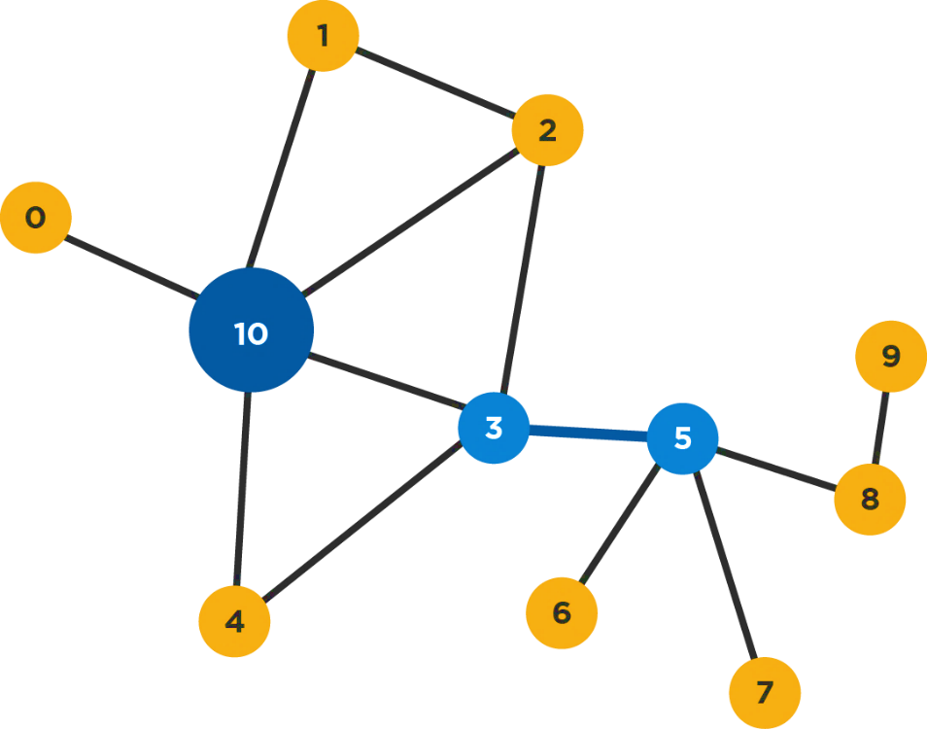
Identifying Sets of Key Players
In the network to the right, node 10 is the most central according to degree centrality
But nodes 3 and 5 together will reach more nodes
Moreover the tie between them is critical; if severed, the network will break into two isolated sub-networks
It follows that other things being equal, players 3 and 5 together are more ‘key’ to this network than 10
Thinking about sets of key players is helpful!

Slide 67
Learning Outline
Handshake with Social Network Analysis
Network Representation
Tie Strength Identification
Influencer Identification
Measuring Overall Social Network Structure

Slide 68
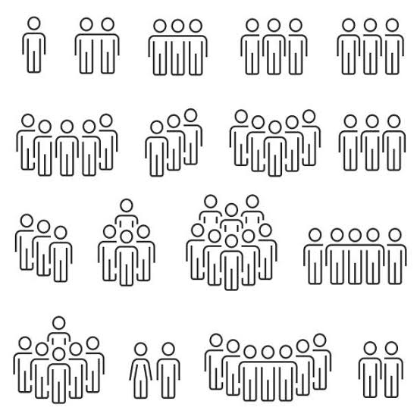

Reciprocity (degree of)
Not
Reciprocal
Reciprocal
The ratio of the number of reciprocated relations over the total number of relations
Notes:
1
Memilih algoritma yang sesuai

Slide 69
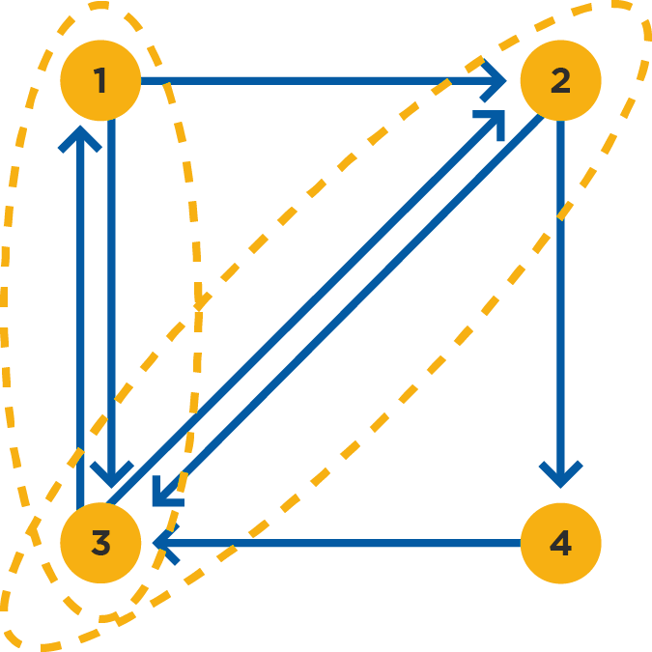
Reciprocity (degree of)
The ratio of the number of relations which are reciprocated (i.e. there is an edge in both directions) over the total number of relations in the network
…where two vertices are said to be related if there is at least one edge between them
In the example to the right this would be 2/5=0.4 (whether this is considered high or low depends on the context)
A useful indicator of the degree of mutuality and reciprocal exchange in a network, which relate to social cohesion
Only makes sense in directed graphs
Reciprocity for network = 0.4
Notes:
1
Memilih algoritma yang sesuai

Slide 70
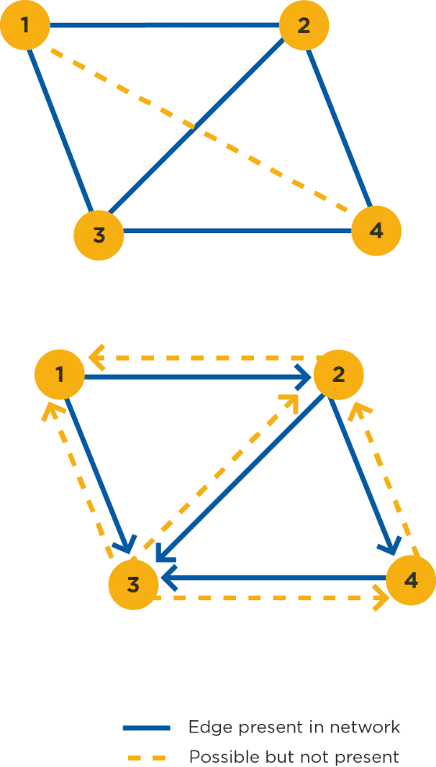
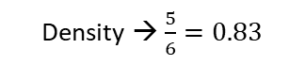
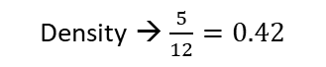
Density
A network’s density is the ratio of the number of edges in the network over the total number of possible edges between all pairs of nodes (which is n(n-1)/2, where n is the number of vertices, for an undirected graph)
In the example network to the right density=5/6=0.83 (i.e. it is a fairly dense network; opposite would be a sparse network)
It is a common measure of how well connected a network is (in other words, how closely knit it is) – a perfectly connected network is called a clique and has density=1
A directed graph will have half the density of its undirected equivalent, because there are twice as many possible edges, i.e. n(n-1)
Density is useful in comparing networks against each other, or in doing the same for different regions within a single network
Density → $\frac{5}{6}=0.83$
Density → $\frac{5}{12}=0.42$

Slide 71
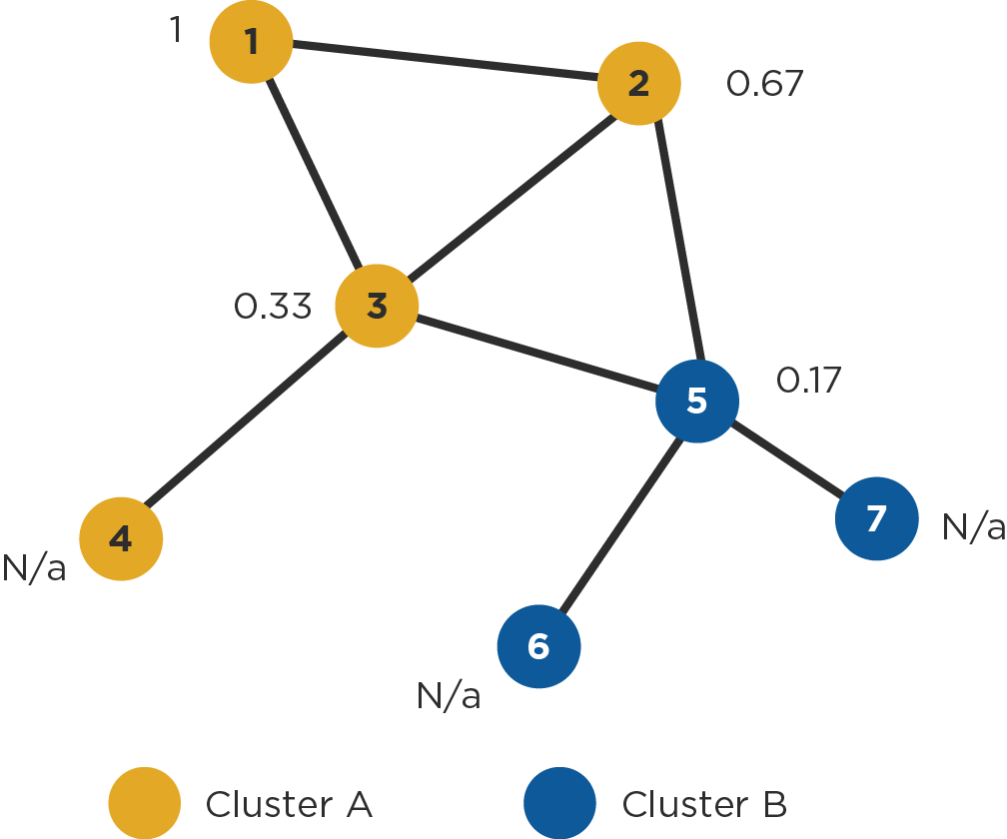
Clustering
A node’s clustering coefficient is the number of closed triplets in the node’s neighborhood over the total number of triplets in the neighborhood. It is also known as transitivity.
E.g., node 1 to the right has a value of 1 because it is only connected to 2 and 3, and these nodes are also connected to one another (i.e. the only triplet in the neighborhood of 1 is closed). We say that nodes 1,2, and 3 form a clique.
Clustering algorithms identify clusters or ‘communities’ within networks based on network structure and specific clustering criteria (example shown to the right with two clusters is based on edge betweenness, an equivalent for edges of the betweenness centrality presented earlier for nodes)
Network clustering coefficient = 0.375
(3 nodes in each triangle x 2 triangles = 6 closed triplets divided by 16 total)

Slide 72
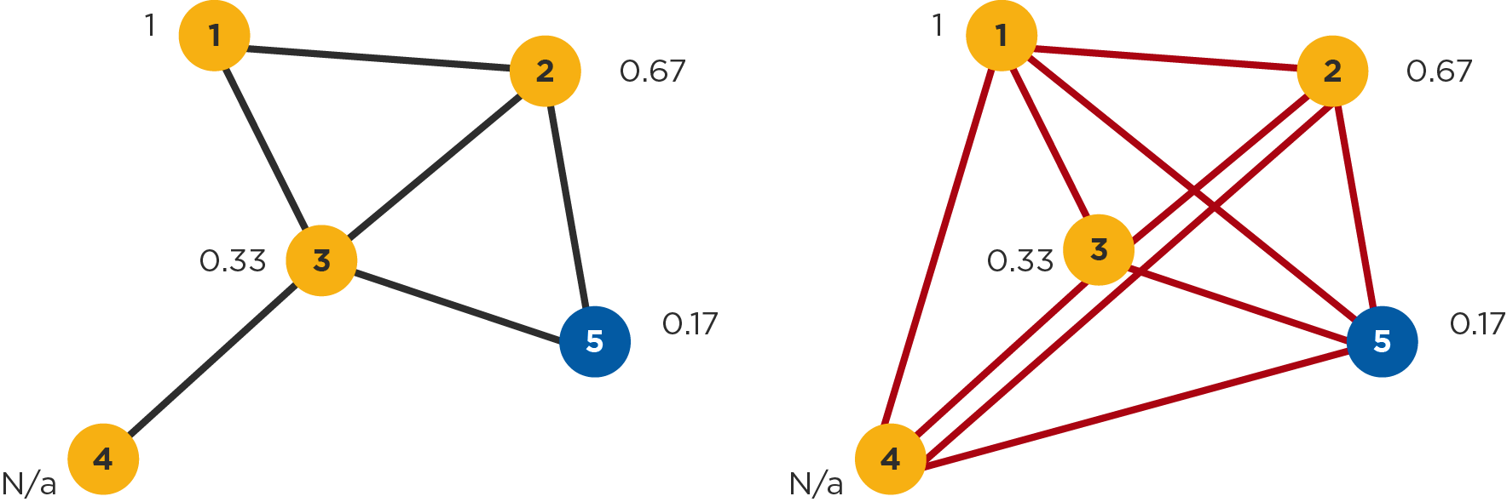
Triplets of Node 3
Possible Number of Triplets

Slide 73
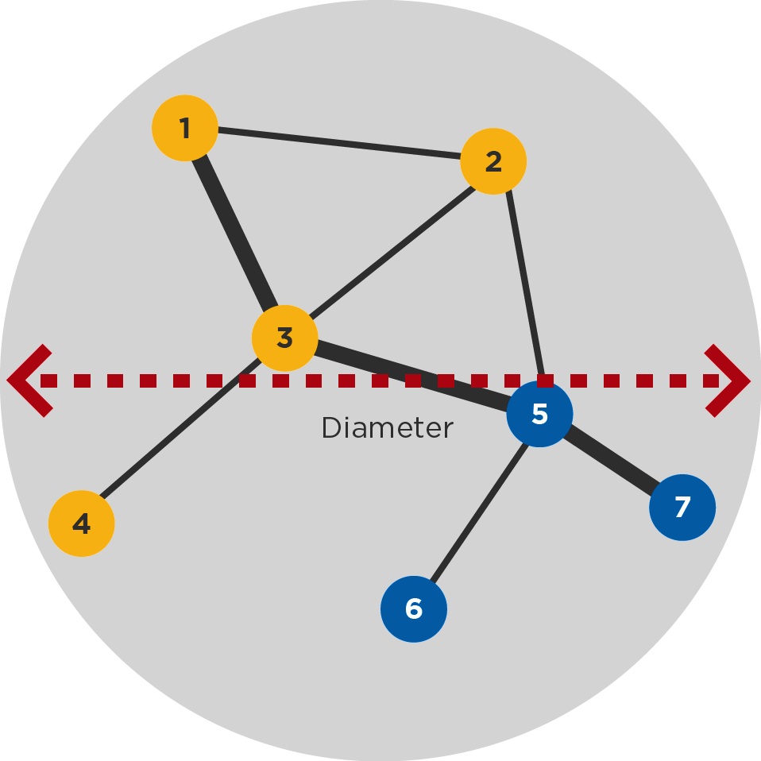
Average and Longest Distance
The longest shortest path (distance) between any two nodes in a network is called the network’s diameter
The diameter of the network on the right is 3; it is a useful measure of the reach of the network (as opposed to looking only at the total number of vertices or edges)
It also indicates how long it will take at most to reach any node in the network (sparser networks will generally have greater diameters)
The average of all shortest paths in a network is also interesting because it indicates how far apart any two nodes will be on average (average distance)

Slide 74
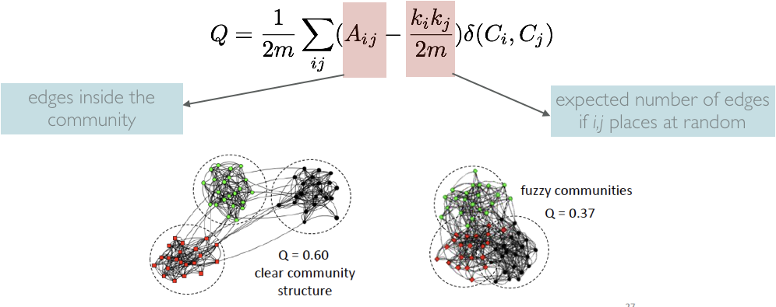
Modularity
Edges inside the community
Expected number of edges if i,j places at random

Slide 75
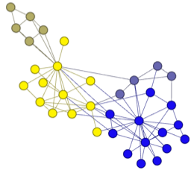
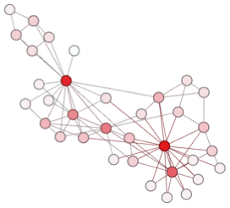
Metric Simulation
modularity
community detection
community detection result
centrality
model network
degree centrality result
Notes:
- Flow chart untuk menghitung centrality dan deteksi komunitas
algorithm centrality : Ulrik Brandes, A Faster Algorithm for Betweenness Centrality, in Journal of Mathematical Sociology 25(2):163-177, (2001)
algoritma deteksi komunitas : Vincent D Blondel, Jean-Loup Guillaume, Renaud Lambiotte, Etienne Lefebvre, Fast unfolding of communities in large networks, in Journal of Statistical Mechanics: Theory and Experiment 2008 (10), P1000
Resolution: R. Lambiotte, J.-C. Delvenne, M. Barahona Laplacian Dynamics and Multiscale Modular Structure in Networks 2009

Slide 76
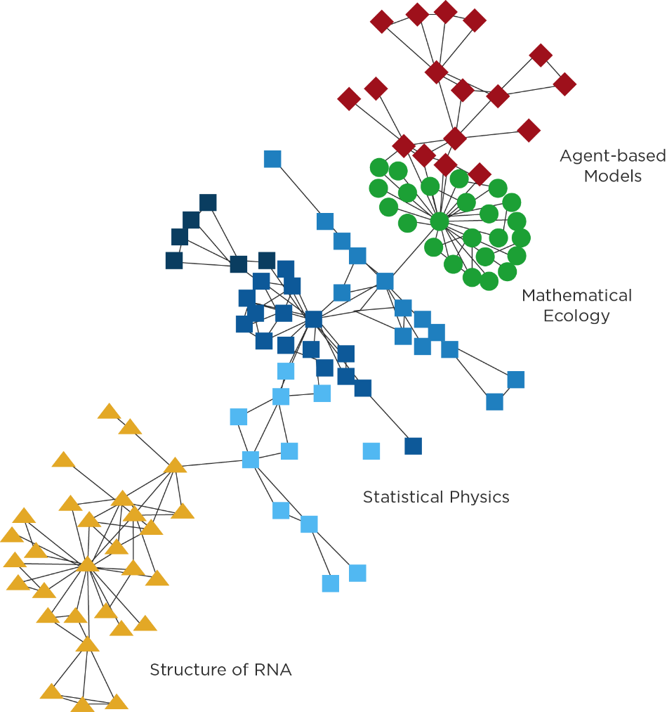
Example : Finding Community
Collaboration network of scientist at Santa Fe Institut (Girvan & Nirwan)
27| scientist (vertices) / 1 | 8 nodes from largest component edge = scientist coauthor one of more publications
Komunitas : kumpulan titik titik dimana jumlah hubungan internal antar titik lebih besar dari pada jumlah hubungan dengan titik eksternal

Slide 77
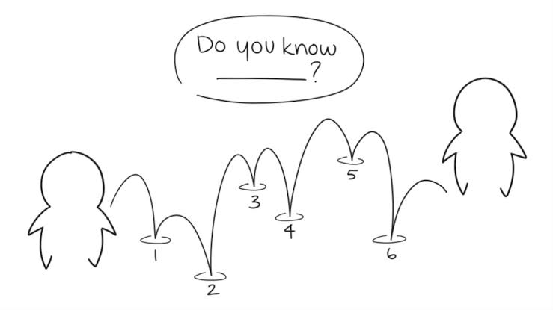
I just need my friend,
friend of my friend, friend of friend of my friend, friend of friend of friend of my friend, friend of friend of friend of friend of my friend, friend of friend of friend of friend of friend of my friend,
to contact him
This is
Peter Parker
This is
Dian

Slide 78
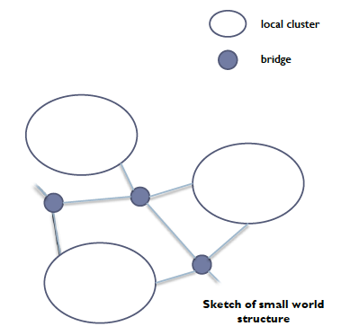
Small Worlds
A small world is a network that looks almost random but exhibits a significantly high clustering coefficient(nodes tend to cluster locally) and a relatively short average path length (nodes can be reached in a few steps
It is a very common structure in social networks because of transitivity in strong social ties and the ability of weak ties to reach across clusters
Such a network will have many clusters but also many bridges between clusters that help shorten the average distance between nodes
You may have heard of the famous “6 degrees” of separations

Slide 79
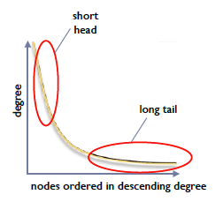
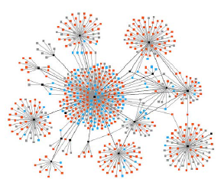
Preferential Attachment
A property of some networks, where, during their evolution and growth in time, a the great majority of new edges are to nodes with an already high degree; the degree of these nodes thus increases disproportionately, compared to most other nodes in the network
The result is a network with few very highly connected nodes and many nodes with a low degree
Such networks are said to exhibit a long-tailed degree distribution
And they tend to have a small-world structure!
(it turns out, transitivity and strong/weak tie characteristics are not neccessary to explain small world structures, but they are common and can also lead to such structures)
Example of network with preferential attachment
Skectch of long-tailed degree distributions

Slide 80
Reasons for Preferential Attachment
POPULARITY | QUALITY | MIXED MODEL
We want to be associated with popular people, ideas, items, thus further increasing their popularity, irrespective of any objective measurable characteristics | We evaluate people and everything else based on objective quality criteria, so higher quality nodes will naturally attract more attention faster | Among nodes of similar attributes, those that reach critical mass first will become ‘star’ with many friends and followers (‘halo effect’)
also known as ‘the rich get richer’ | also known as ‘the good get better’ | may be impossible to predict who will become a star, even if quality matters

Slide 81
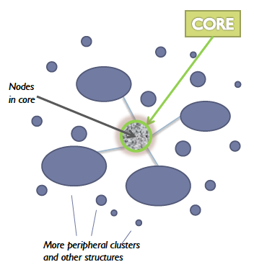
Core-Periphery Structures
A useful and relatively simple metric of the degree to which a social network is centralized or decentralized, is the centralization measure (usually normalized such that it takes values between 0 and 1)
It is based on calculating the differences in degrees between nodes; a network that greatly depends on 1-2 highly connected nodes (as a result for example of preferential attachment) will exhibit greater differences in degree centrality between nodes
Centralized structures can perform better at some tasks (like team-based problem-solving requiring coordination), but are more prone to failure if key players disconnect
In addition to centralization, many large groups and online communities have a core of densely connected users that are critical for connecting a much larger periphery
Cores can be identified visually, or by examining the location of high-degree nodes and their joint degree distributions (do high-degree nodes tend to connect to other high-degree nodes?)
Bow-tie analysis, famously used to analyze the structure of the Web, can also be used to distinguish between the core and other, more peripheral elements in a network

Slide 82
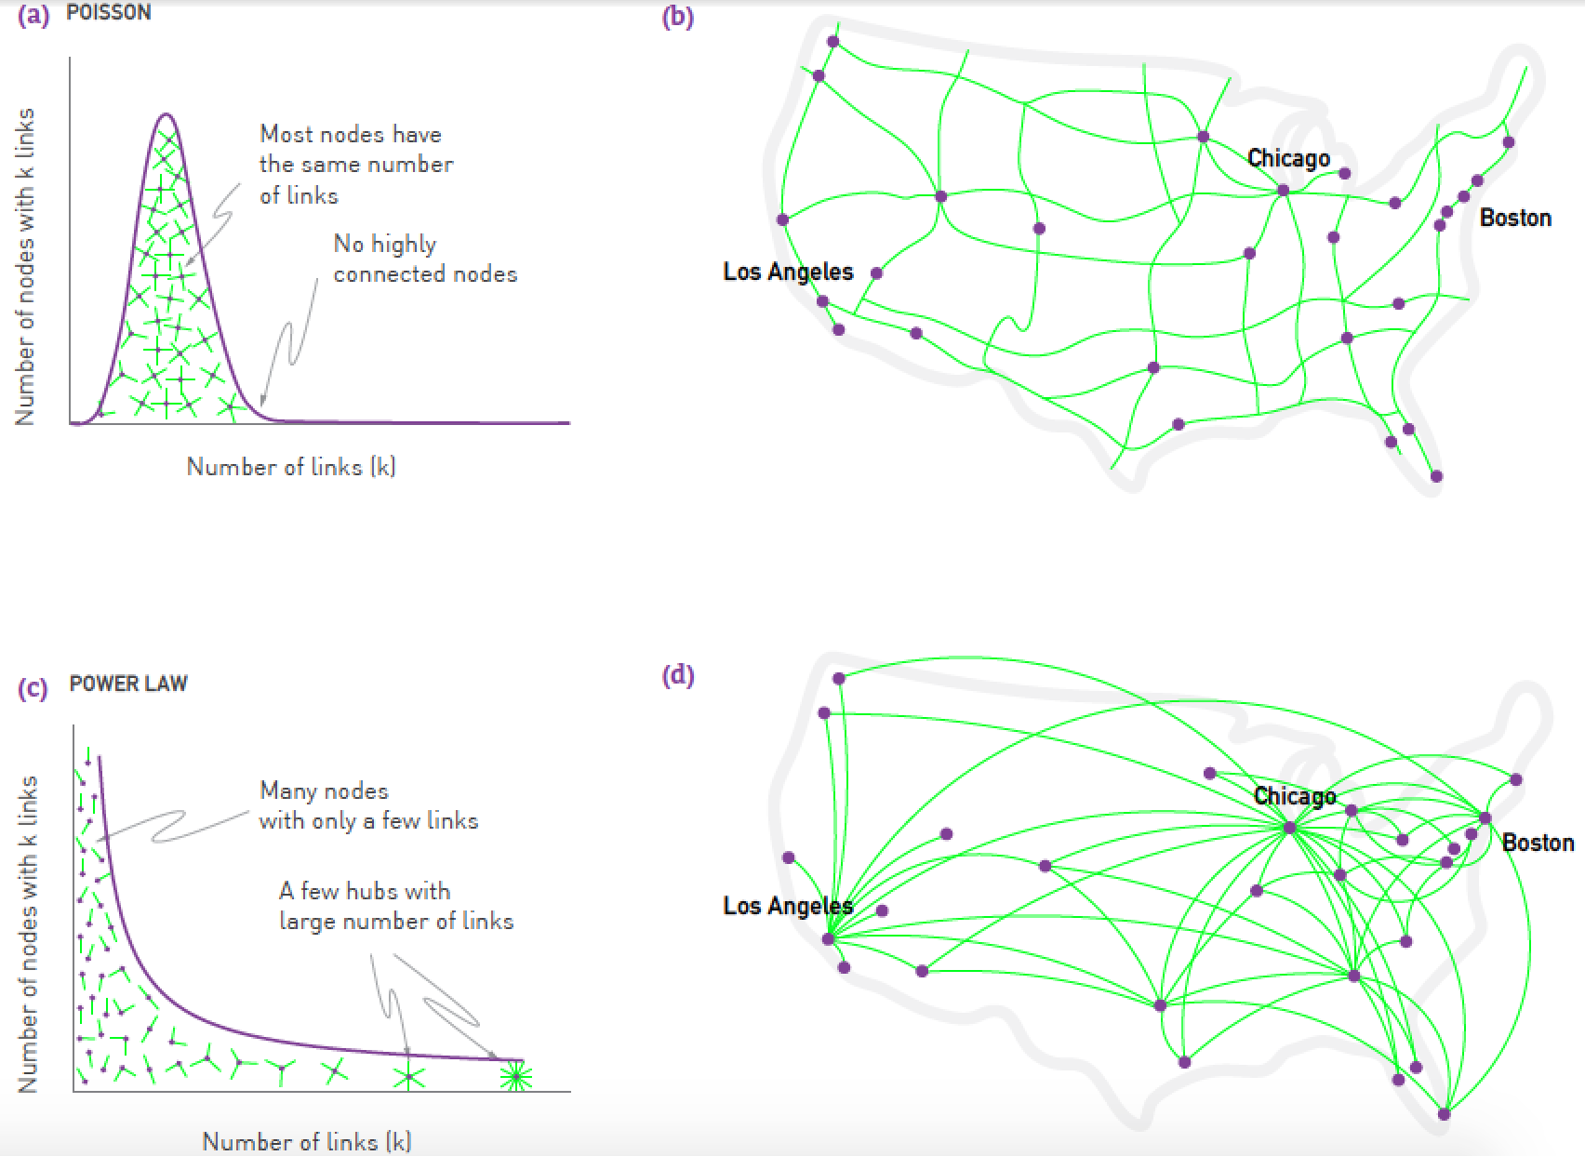
Social Network Characteristic

Slide 83

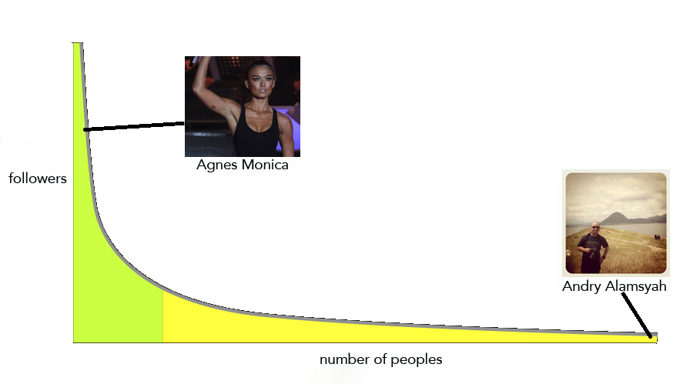
Social Network Characteristic: Power Law
power law distributions

Slide 84


Practice: Constructing Interaction Graph
Notes:
Finding relations, causal, cluster, class, associate
2
3
Event simulation => blackbox methodology (ANN)

Slide 85

Thank You! It’s time for a break. See you at 10:15

Slide 86
Collecting Social Media Data
3
Social Media Analytic Workshop

Slide 87
M. Apriandito Arya Saputra
Freelance Data Evangelist
Former Data Scientist at Paperlust.Co
Public Relations at Asosiasi Ilmuwan Data Indonesia
Bachelor of Management, Telkom University
Master of Business Administration Student, Institut Teknologi Bandung
Phone : +628112770063
Email : m.apriandito@gmail.com

Slide 88
Research And Publication
Object Detection using Convolutional Neural Network to Identify Popular Fashion Product. (Journal of Physics: Conference Series Volume 1192, Number 1)
A Comparative Study of Hollywood Movie Successfulness Prediction Model.
Forecasting Portfolio Optimization using Artificial Neural Network and Genetic Algorithm.
Analysis of Customer Chat using Text Mining for Customer Relationship Management.
Hotel Preference Rank based on Online Customer Review.

Slide 89
Learning Outline
Introduction
Collecting Data from Twitter
Constructing Online Interaction Graph
Collecting Data from Social Forum

Slide 90
Collecting Data from Social Media
First, the most direct way is to download the data from databases on the web servers.
The second method is collecting data through application programming interfaces (APIs).
The third method is web scraping. This method is particularly useful for those web-sites that do not provide APIs.

Slide 91
Ethical issues
Harvesting social media data may lead to an unwanted and unforeseen exposure of private data for participants .Large quantities of personal information on social media.
Informed consent
Participant anonymity

Slide 92
Learning Outline
Handshake with Social Media Data
Collecting Data from Twitter
Constructing Online Interaction Graph
Collecting Data from Social Forum

Slide 93

Practice: Collecting Twitter Data Using R
Practice Link: https://github.com/sma-workshop/r

Slide 94


Practice: Collecting Twitter Data Using Python
Practice Link: https://github.com/sma-workshop/python

Slide 95
Learning Outline
Handshake with Social Media Data
Collecting Data from Twitter
Constructing Online Interaction Graph
Collecting Data from Social Forum

Slide 96
Build the Dataset
screen_name = Source | reply_to_screen = Target
Dian | Rizqy
Dito | Rizqy
Dito | Dian
… | …
Notes:
1
Memilih algoritma yang sesuai

Slide 97

Practice: Constructing Online Interaction Graph
Notes:
Finding relations, causal, cluster, class, associate
2
3
Event simulation => blackbox methodology (ANN)

Slide 98
Learning Outline
Handshake with Social Media Data
Collecting Data from Twitter
Constructing Online Interaction Graph
Collecting Data from Social Forum

Slide 99

Practice: Collecting Review Data

Slide 100

Thank You! It’s time for a break. See you at 13:00

Slide 101
Text Mining
4
Social Media Analytic Workshop

Slide 102
Learning Outline
Introduction to Text Mining
Text Preprocessing
Text Classification: Sentiment Analysis
Topic Modelling
Text Network Analysis

Slide 103
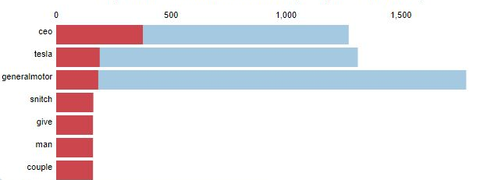
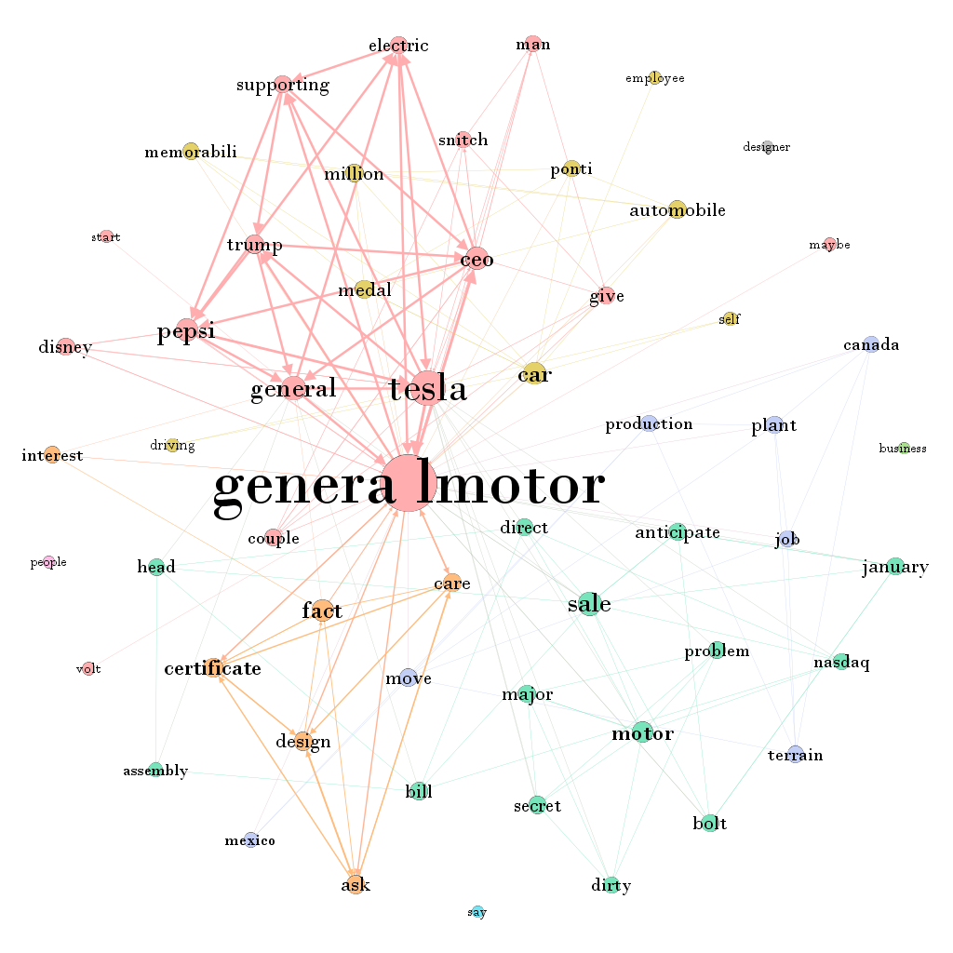
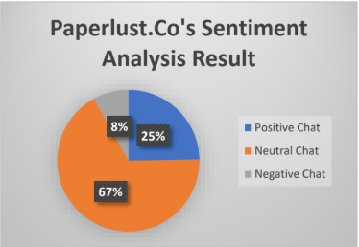
Text Mining
According to Wikipedia, “Text mining, also referred to as text data mining, roughly equivalent to text analytics, is the process of deriving high-quality information from text.”
Text mining combines notions of statistics, linguistics, and machine learning to create models that learn from training data and can predict results on new information based on their previous experience.

Slide 104



Data Mining and Text Mining
Data Mining
Output
Text Mining
Important Keyword:
Ricuh
Mahasiswa
DPR
Aparat
Desak
Masuk
Output

Slide 105
Learning Outline
Introduction to Text Mining
Text Preprocessing
Text Classification: Sentiment Analysis
Topic Modelling
Text Network Analysis

Slide 106


Everything was fine,
until you meet Indonesian Language

Slide 107
Pre-Precessing Type | Result
Tokenization | O gitu caranya banya followers bikin GA ipon, pas sudah banyak yang pollow GAnya gajadi diumumin deh atau bilangnya sudah ada yang menang hhhhhh Bisa saja klean ini ngibulnya
Slang word | O gitu caranya banyak followers bikin GA iphone, pas sudah banyak yang follow GAnya tidak jadi diumumin deh atau bilangnya sudah ada yang menang hhhhhh Bisa saja kalian ini ngibulnya
Stemming | O gitu cara banyak followers bikin GA iphone, pas sudah banyak yang follow GA tidak jadi umum deh atau bilang sudah ada yang menang hhhhhh Bisa saja kalian ini ngibul
Lemmatization | O gitu cara banyak followers buat GA iphone, pas sudah banyak yang follow GA tidak jadi umum deh atau sebut sudah ada yang menang hhhhhh Bisa saja kalian ini tipu
Stop word | cara banyak followers GA iphone, banyak follow GA tidak umum sebut menang kalian tipu.

Slide 108
Practice: Pre-Processing Text Data Using R
Practice Link: https://github.com/sma-workshop/r

Slide 109
Learning Outline
Introduction to Text Mining
Text Preprocessing
Text Classification: Sentiment Analysis
Topic Modelling
Text Network Analysis

Slide 110


Text Classification
Text classification also known as text tagging or text categorization is the process of categorizing text into organized groups. Some of the most common examples and use cases for automatic text classification is Sentiment Analysis.

Slide 111


Create Sentiment Analysis Model
It is using Machine Learning Principle
Machine Learning Algorithm

Slide 112
Practice: Sentiment Analysis Using R
Practice Link: https://github.com/sma-workshop/r

Slide 113
Practice: Sentiment Analysis Using Python
Practice Link: https://github.com/sma-workshop/python

Slide 114
Learning Outline
Introduction to Text Mining
Text Preprocessing
Text Classification: Sentiment Analysis
Topic Modelling
Text Network Analysis

Slide 115

Topic Modelling
Topic modeling is a type of statistical modeling for discovering the abstract “topics” that occur in a collection of documents..
LDA is easily the most popular (and typically most effective) topic modeling technique out there.

Slide 116
Practice: LDA Topic Modelling Using Python
Practice Link: https://github.com/sma-workshop/python

Slide 117
Practice: LDA Topic Modelling Using R
Practice Link: https://github.com/sma-workshop/r

Slide 118
Learning Outline
Introduction to Text Mining
Text Preprocessing
Text Classification: Sentiment Analysis
Topic Modelling
Text Network Analysis

Slide 119
Text Network Analysis
The analysis of text describing various kinds of "computer support solution" that allows the analyst to "extract networks of concepts" from text
The assumption underlying the emergence text network is a relationship that is contained in every word so that it produces a pattern that can be analyzed

Slide 120

Practice: Text Network Analysis

Slide 121
See You Again at Telkom University

